Slide 1
Document object model

Slide 2
javascript
JavaScript evolved with the code abstraction in mind. It was implemented with following sections.
Core (Ecma Script Specifications)
DOM (Document Object Model)
BOM (Browser Object Model)

Slide 3
Core
Includes the core features of JavaScript programming language – How to write variables, data types, control loops, conditional statements, operators etc.
The core entirely depends on the browser vendor. can add or remove core functions.
Most of the major browsers today are close to ECMA script standards such as Chrome, Firefox, Internet Explorer 9 & 10, Safari, Opera.

Slide 4
Document object model
The DOM in JavaScript is the API (Application Programming Interface) to access the elements inside the document.
Maps the entire Document into an hierarchy of parent and child tree.
Each node can hold number of children element or can inherit to other parent element in some or the other way.
One can access each element and it’s properties using the DOM structure.
Model describes how the element inherits the property of another element.

Slide 5
BOM (Browser Object Model)
The BOM allows the access to manipulate the Browser’s window, which may consist following objects.
navigator
location
document (DOM)
history
screen
Array of frames
Using BOM one can modify, move the window or can change the text in status bar, read the current URL, hast tag, go back or forward of the current page which otherwise not possible with DOM
BOM depends on browser vendor who may or may not include additional features to it

Slide 6
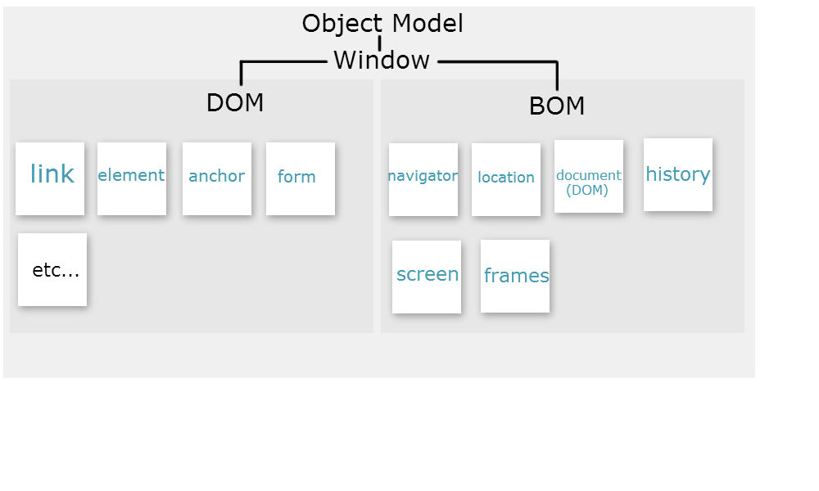
Object window model

Slide 7


Slide 8
dom
With the object model, JavaScript gets all the power it needs to create dynamic HTML:
Can change all the HTML elements in the page
Can change all the HTML attributes in the page
Can change all the CSS styles in the page
Can remove existing HTML elements and attributes
Can add new HTML elements and attributes
Can react to all existing HTML events in the page
Can create new HTML events in the page

Slide 9
dom
Is a W3C (World Wide Web Consortium) standard.
Defines a standard for accessing documents:
"The W3C Document Object Model (DOM) is a platform and language-neutral interface that allows programs and scripts to dynamically access and update the content, structure, and style of a document."
The W3C DOM standard is separated into 3 different parts:
Core DOM - standard model for all document types
XML DOM - standard model for XML documents
HTML DOM - standard model for HTML documents

Slide 10
Html dom
Is a standard object model and programming interface for HTML.
Is a standard for how to get, change, add, or delete HTML elements.
It defines:
The HTML elements as objects
The properties of all HTML elements
The methods to access all HTML elements
The events for all HTML elements

Slide 11
DOM Programming Interface
can be accessed with JavaScript (and with other programming languages).
In the DOM, all HTML elements are defined as objects.
The programming interface is the properties and methods of each object.
A property is a value that you can get or set (like changing the content of an HTML element).
A method is an action you can do (like add or deleting an HTML element).

Slide 12
Finding HTML Elements
Methods
document.getElementById(id)
document.getElementsByTagName(name)
document.getElementsByClassName(name)

Slide 13
Changing HTML Elements
Method Description
element.innerHTML = new html content Change the inner HTML of an
element
element.attribute = new value Change the attribute value of an HTML element
element.setAttribute(attribute, value) Change the attribute value of an
HTML element
element.style.property = new style Change the style of an HTML
element

Slide 14
Adding and Deleting Elements
Method Description
document.createElement(element) Create an HTML element
document.removeChild(element) Remove an HTML element
document.appendChild(element) Add an HTML element
document.replaceChild(element) Replace an HTML element
document.write(text) Write into the HTML output
stream

Slide 15
Adding Events Handlers
document.getElementById(id).onclick = function(){ code }
//Adding event handler code to an onclick event
button1.onclick=function()
{
console.log(‘HI’);
}

Slide 16
Finding HTML Elements
Finding HTML elements by id
Finding HTML elements by tag name
Finding HTML elements by class name
Finding HTML elements by CSS selectors
Finding HTML elements by HTML object collections

Slide 17
Finding HTML Element by Id
Easiest way to find an HTML element in the DOM, is by using the element id.
To find the element with id="intro":
Example
var myElement = document.getElementById("intro");
If the element is found, the method will return the element as an object (in myElement).
If the element is not found, myElement will contain null.

Slide 18
Finding HTML Elements by Tag Name
To find all the elements using the HTML tag
To find all <p> elements:
Example
var x = document.getElementsByTagName("p");

Slide 19
Finding HTML Elements by Class Name
To find all HTML elements with the same class name - getElementsByClassName().
To return a list of all elements with class="intro".
Example
var x = document.getElementsByClassName("intro");

Slide 20
Finding HTML Elements by CSS Selectors
To find all HTML elements that matches a specified CSS selector (id, class names, types, attributes, values of attributes, etc) - querySelectorAll() method.
To return a list of all <p> elements with class="intro".
Example
var x = document.querySelectorAll("p.intro");

Slide 21
Finding HTML Elements by HTML Object Collections
To find the form element with id="frm1", in the forms collection, and displays all element values:
Example
var x = document.forms["frm1"]; var text = ""; var i; for (i = 0; i < x.length; i++) { text += x.elements[i].value + "<br>"; } document.getElementById("demo").innerHTML = text;

Slide 22
Finding HTML Elements by HTML Object Collections
Following HTML objects (and object collections) are also accessible:
document.anchors
document.body
document.documentElement
document.embeds
document.forms
document.head
document.images
document.links
document.scripts
document.title

Slide 23
Examples
var x = document.getElementById("main"); var y = x.getElementsByTagName("p");
//finds the element with id="main", and then finds all <p> elements inside "main"

Slide 24
Changing the HTML Output Stream
JavaScript can create dynamic HTML content:
document.write() can be used to write directly to the HTML output stream:
Example
<!DOCTYPE html> <html> <body> <script> document.write(Date()); </script> </body> </html>

Slide 25
Changing HTML Content
Easiest way to modify the content of an HTML element is by using the innerHTML property.
document.getElementById(id).innerHTML = new HTML
Example below changes the content of a <p> element:
<html>
<body>
<p id="p1">Hello World!</p>
<script>
document.getElementById("p1").innerHTML = "New text!";
</script>
</body>
</html>

Slide 26
Changing HTML Content
Eample changes the content of an <h1> element:
<html>
<body>
<h1 id="header">Old Header</h1>
<script>
var element = document.getElementById("header");
element.innerHTML = "New Header";
</script>
</body>
</html>

Slide 27
Changing the Value of an Attribute
To change the value of an HTML attribute, use this syntax:
document.getElementById(id).attribute=new value
Example changes the value of the src attribute of an <img> element:
<!DOCTYPE html> <html> <body> <img id="myImage" src="smiley.gif"> <script> document.getElementById("myImage").src = "landscape.jpg"; </script> </body> </html>

Slide 28
JavaScript HTML DOM - Changing CSS

Slide 29
Changing HTML Style
To change the style of an HTML element
document.getElementById(id).style.property=new style
Example changes the style of a <p> element:
<html>
<body>
<p id="p2">Hello World!</p>
<script>
document.getElementById("p2").style.color = "blue";
</script>
<p>The paragraph above was changed by a script.</p>
</body>
</html>

Slide 30
Using Events
HTML DOM allows you to execute code when an event occurs.
Events are generated by the browser when "things happen" to HTML elements:
An element is clicked on
The page has loaded
Input fields are changed

Slide 31
Reacting to Events
A JavaScript can be executed when an event occurs, like when a user clicks on an HTML element.
To execute code when a user clicks on an element, add JavaScript code to an HTML event attribute:
onclick=JavaScript
Examples of HTML events:
When a user clicks the mouse
When a web page has loaded
When an image has been loaded
When the mouse moves over an element
When an input field is changed
When an HTML form is submitted
When a user strokes a key

Slide 32
Onclick event
<!DOCTYPE html> <html> <body> <h1 id="id1">My Heading 1</h1> <button type="button" onclick="document.getElementById('id1').style.color = 'red'"> Click Me!</button> </body> </html><!DOCTYPE html> <html> <body> <h1 id="id1">My Heading 1</h1> <button type="button" onclick="document.getElementById('id1').style.color = 'red'"> Click Me!</button> </body> </html>

Slide 33
Onclick event
<html>
<body>
<p id="p1">
This is a text.
This is a text.
This is a text.
This is a text.
</p>
<input type="button" value="Hide text" onclick="document.getElementById('p1').style.visibility='hidden'">
<input type="button" value="Show text" onclick="document.getElementById('p1').style.visibility='visible'">
</body>
</html>

Slide 34
Assign Events Using the HTML DOM
The HTML DOM allows to assign events to HTML elements using JavaScript:
To Assign an onclick event to a button element:
<script>
document.getElementById("myBtn").onclick = displayDate;
function displayDate() {
document.getElementById("demo").innerHTML = Date();
}
</script>

Slide 35
onload and onunload Events
The onload and onunload events are triggered when the user enters or leaves the page.
The onload event can be used to check the visitor's browser type and browser version, and load the proper version of the web page based on the information.
The onload and onunload events can be used to deal with cookies.
<body onload="checkCookies()">

Slide 36
onload and onunload Events
<script>
function checkCookies() {
var text = "";
if (navigator.cookieEnabled == true) {
text = "Cookies are enabled.";
} else {
text = "Cookies are not enabled.";
}
document.getElementById("demo").innerHTML = text;
}
</script>

Slide 37
onchange Event
onchange event is often used in combination with validation of input fields.
upperCase() function will be called when a user changes the content of an input field.
<input type="text" id="fname" onchange="myFunction()">
<script>
function myFunction() {
var x = document.getElementById("fname");
x.value = x.value.toUpperCase();
}
</script>
Example: javascript demos\onchangeevent.html

Slide 38
onmouseover and onmouseout Events
The onmouseover and onmouseout events can be used to trigger a function when the user mouses over, or out of, an HTML element
Example : javascript demos\onmouseoverout.html

Slide 39
onmousedown, onmouseup and onclick Events
The onmousedown, onmouseup, and onclick events are all parts of a mouse-click.
First when a mouse-button is clicked, the onmousedown event is triggered
Then, when the mouse-button is released, the onmouseup event is triggered
And finally, when the mouse-click is completed, the onclick event is triggered.
Example : javascript demos\onmouseupdown.html

Slide 40
examples
javascript demos\onloadevent.html
javascript demos\onfocus.html
javascript demos\onmouseupdown1.html
javascript demos\animationeg1.html
javascript demos\analogclock.html

Slide 41
HTML DOM EventListener
addEventListener() method :
Attaches an event handler to the specified element.
Attaches an event handler to an element without overwriting existing event handlers.
Can add many event handlers to one element.
Can add many event handlers of the same type to one element, i.e two "click" events.
Can add event listeners to any DOM object not only HTML elements. i.e the window object.
Makes it easier to control how the event reacts to bubbling.
JavaScript is separated from the HTML markup, for better readability and allows you to add event listeners even when you do not control the HTML markup.

Slide 42
addEventListener() method
Syntax
element.addEventListener(event, function, useCapture);
First parameter is the type of the event (like "click" or "mousedown").
Second parameter is the function to call when the event occurs.
Third parameter is a boolean value specifying whether to use event bubbling or event capturing.optional.

Slide 43
addEventListener() method
element.addEventListener("click", function(){ alert("Hello World!"); });
document.getElementById("myBtn").addEventListener("click", displayDate);
document.getElementById("myBtn").addEventListener("click", function(){
alert("Hello World!");

Slide 44
Add Many Event Handlers to the Same Element
var x = document.getElementById("myBtn");
x.addEventListener("click", myFunction);
x.addEventListener("click", someOtherFunction);
function myFunction() {
alert ("Hello World!");
}
function someOtherFunction() {
alert ("This function was also executed!");
}

Slide 45
add events of different types to the same element
element.addEventListener("mouseover", myFunction); element.addEventListener("click", mySecondFunction); element.addEventListener("mouseout", myThirdFunction);

Slide 46
Event Handler to the Window Object
window.addEventListener("resize", function(){
document.getElementById("demo").innerHTML = Math.random();
javascript demos\windowdemo1.html
javascript demos\windowopen.html

Slide 47
Passing Parameters
When passing parameter values, use an "anonymous function" that calls the specified function with the parameters
<script>
var p1 = 5;
var p2 = 7;
document.getElementById("myBtn").addEventListener("click", function() {
myFunction(p1, p2);
});
function myFunction(a, b) {
var result = a * b;
document.getElementById("demo").innerHTML = result;
}
</script>

Slide 48
Event Bubbling And Event Capturing
Two ways of event propagation in the HTML DOM - bubbling and capturing.
Event propagation is a way of defining the element order when an event occurs. If you have a <p> element inside a <div> element, and the user clicks on the <p> element, which element's "click" event should be handled first?
In bubbling the inner most element's event is handled first and then the outer: the <p> element's click event is handled first, then the <div> element's click event.
In capturing the outer most element's event is handled first and then the inner: the <div> element's click event will be handled first, then the <p> element's click event.

Slide 49
addEventListener() method
addEventListener() method - Can specify the propagation type by using the "useCapture" parameter:
addEventListener(event, function, useCapture);
The default value is false, which will use the bubbling propagation
When the value is set to true, the event uses the capturing propagation.
Example : javascript demos\capturebubble.html

Slide 50
removeEventListener() method
removeEventListener() method removes event handlers that have been attached with the addEventListener() method:
element.removeEventListener("mousemove", myFunction);
Example : javascript demos\removeeventlistener.html

Slide 51
HTML DOM Navigation

Slide 52
DOM Nodes
According to the W3C HTML DOM standard, everything in an HTML document is a node:
The entire document is a document node
Every HTML element is an element node
The text inside HTML elements are text nodes
Every HTML attribute is an attribute node
All comments are comment nodes
New nodes can be created, and all nodes can be modified or deleted.

Slide 53
Properties of dom elements
<title>DOM Tutorial</title>
the element node <title> does not contain text. It contains a text node with the value "DOM Tutorial".
The value of the text node can be accessed by the node's innerHTML property, or the nodeValue.

Slide 54
DOM Root Nodes
Two special properties that allow access to the full document:
document.body - The body of the document
document.documentElement - The full document

Slide 55
Navigating Between Nodes
Node properties to navigate between nodes with JavaScript:
parentNode
childNodes[nodenumber]
firstChild
lastChild
nextSibling
previousSibling

Slide 56
childNodes[nodenumber]
<html>
<body>
<h1 id="intro">My First Page</h1>
<p id="demo">Hello World!</p>
<script>
var myText = document.getElementById("intro").childNodes[0].nodeValue;
document.getElementById("demo").innerHTML = myText;
</script>
</body>
</html>

Slide 57
firstChild
<html>
<body>
<h1 id="intro">My First Page</h1>
<p id="demo">Hello World!</p>
<script>
myText = document.getElementById("intro").firstChild.nodeValue;
document.getElementById("demo").innerHTML = myText;
</script>
</body>
</html>

Slide 58
nodeName Property
Specifies the name of a node.
nodeName is read-only
nodeName of an element node is the same as the tag name
nodeName of an attribute node is the attribute name
nodeName of a text node is always #text
nodeName of the document node is always #document

Slide 59
nodeValue Property
Specifies the value of a node.
nodeValue for element nodes is undefined
nodeValue for text nodes is the text itself
nodeValue for attribute nodes is the attribute value

Slide 60
nodeType Property
The nodeType property returns the type of node. nodeType is read only.
The most important node types are:
Element type NodeType
Element 1
Attribute 2
Text 3
Comment 8
Document 9

Slide 61
Creating New HTML Elements (Nodes)
<script>
var para = document.createElement("p");
var node = document.createTextNode("This is new.");
para.appendChild(node);
var element = document.getElementById("div1");
element.appendChild(para);
</script>

Slide 62
Creating new HTML Elements - insertBefore()
<script>
var para = document.createElement("p");
var node = document.createTextNode("This is new.");
para.appendChild(node);
var element = document.getElementById("div1");
var child = document.getElementById("p1");
element.insertBefore(para,child);
</script>

Slide 63
Removing Existing HTML Elements
<div id="div1">
<p id="p1">This is a paragraph.</p>
<p id="p2">This is another paragraph.</p>
</div>
<script>
var parent = document.getElementById("div1");
var child = document.getElementById("p1");
parent.removeChild(child);
</script>

Slide 64
Replacing HTML Elements
<div id="div1">
<p id="p1">This is a paragraph.</p>
<p id="p2">This is another paragraph.</p>
</div>
<script>
var para = document.createElement("p");
var node = document.createTextNode("This is new.");
para.appendChild(node);
var parent = document.getElementById("div1");
var child = document.getElementById("p1");
parent.replaceChild(para,child);
</script>

Slide 65
HTML DOM Node List
var myNodelist = document.getElementsByTagName("p"); var i; for (i = 0; i < myNodelist.length; i++) { myNodelist[i].style.backgroundColor = "red"; }

Slide 66


